Slide 1
The Introduction to Stack & Queue
Wu Shuaiyi
ACM Team ,Zhejiang Gongshang University

Slide 2
How about LinkList?
Let’s review
Have you done tasks before this class?
Can you realize Double Linked list? And Circular Linklist?
Have you done ur personal templates?
Make true you’ve get the hang of LinkList.
Additional Reminder:
You can turn to ur master for all ur questions
( Include Algorithm problems, study and affective interaction )

Slide 3
Course Target
Get the hang of Stack and Queue and realize them
Choose Stack or Queue for different conditions
Do homework by ur own

Slide 4
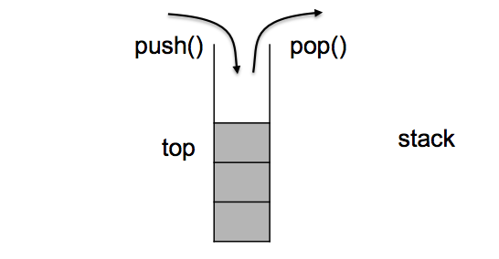

First in last out (FILO) Stack
From Wikipedia, the free encyclopedia
Stack may refer to:
A pile or mound of something
Computers
Stack (abstract data type), abstract data type and data structure based on the principle of Last In First Out (LIFO)

Slide 5
Easy Task #1
Given an input string
Reverse the string word by word.
For example, Given s = "the sky is blue“
Return "blue is sky the".

Slide 6
Easy Task #2
POJ 1028 Web Navigation
Descirption on web

Slide 7
First in first out (FIFO) Queue
From Wikipedia, the free encyclopedia
In computer science:
Queue (abstract data type), a type of data structure in computer science
Double ended queue, also known as a deque
Priority queue
Circular queue

Slide 8
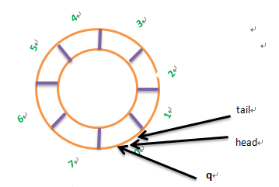
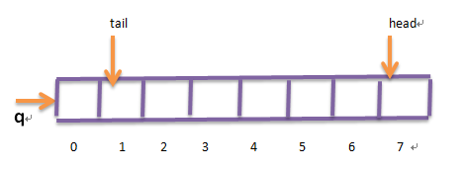
First in first out (FIFO) Queue
当我们一看到要频繁的插入、删除元素，第一反应就是中链表实现。的确，在原有链表的基础上，稍作改动，就能把它变成一个队列。但是，程序员们想出了一个更加巧妙地办法，利用数组，准确的说，是循环数组，来方便而快速的实现队列。

Slide 9
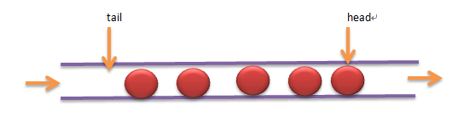
First in first out (FIFO) Queue
InitQueue（） ——初始化队列
EnQueue（） ——进队列
DeQueue（） ——出队列
IsQueueEmpty（）——判断队列是否为空
IsQueueFull（） ——判断队列是否已满

Slide 10
Easy Task #3
Realize EnQueue () and DeQueue ()

Slide 11
Easy Task #4
Given an input string
Reverse the string word by word.
For example, Given s = "the sky is blue“
Return " the sky is blue".
( DO BY QUEUE )

Slide 12
Challenge Task #5 ( Interview questions )
Provide you with 2 Stack
And realize these funcions like Queue or simulate
Push , Pop and calculate the size of Queue

Slide 13
Question?

Slide 14
Reference
队列 - http://blog.csdn.net/luoweifu/article/details/8507835
栈和队列 –
http://blog.csdn.net/mig_davidli/article/details/9749465

Slide 15
Thank you
Personal Information
Class: CS1301
Email: wushuaiyi@outlook.com
QQ: 100103398

